Slide 1
Visualising Billions of sequence reads with SalCom & JBrowse…
… and R
Karsten Hokamp
9th Feb 2014

Slide 2
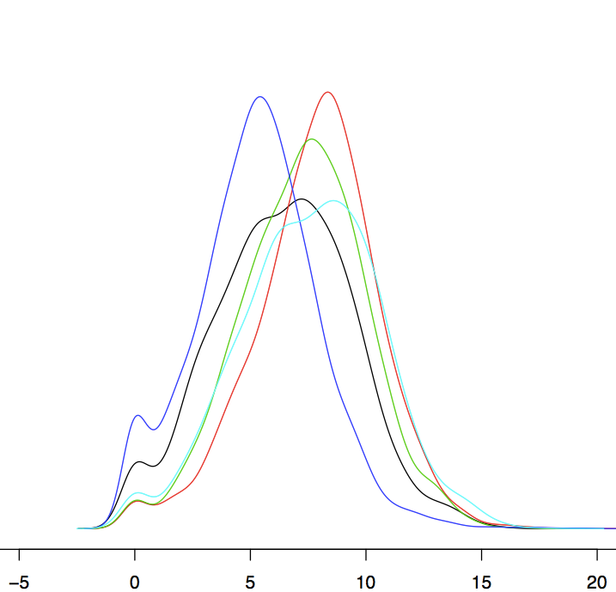
R plots for data checks
Expression density plots:
High-level visualisation of data distribution
Comparison between different samples and normalisations
density
gene expression measurement

Slide 3
raw read counts per gene
density
log2-scale

Slide 4
DESeq-normalised counts
density
log2-scale

Slide 5
RPKM values
density
log2-scale

Slide 6
TPM values
density
log2-scale

Slide 7
Raw
TPM
RPKM
DESeq

Slide 8
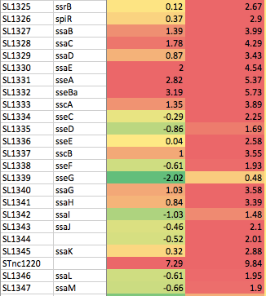
EEP / LPS on log2-scale
TPM
DESeq

Slide 9
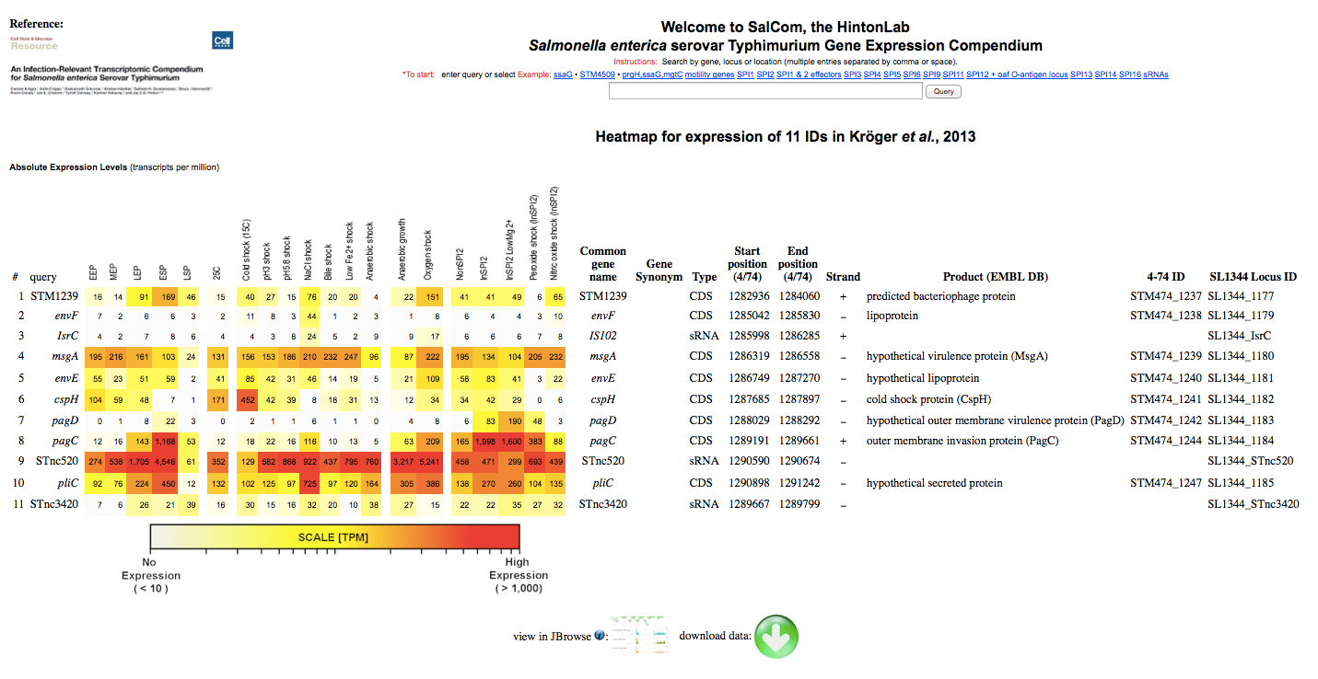
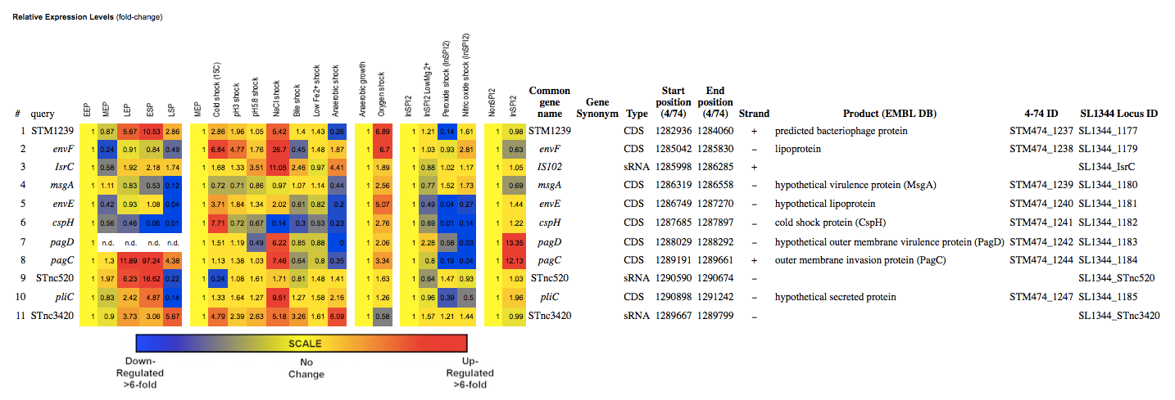
SalCom
bioinf.gen.tcd.ie/cgi-bin/salcom

Slide 10
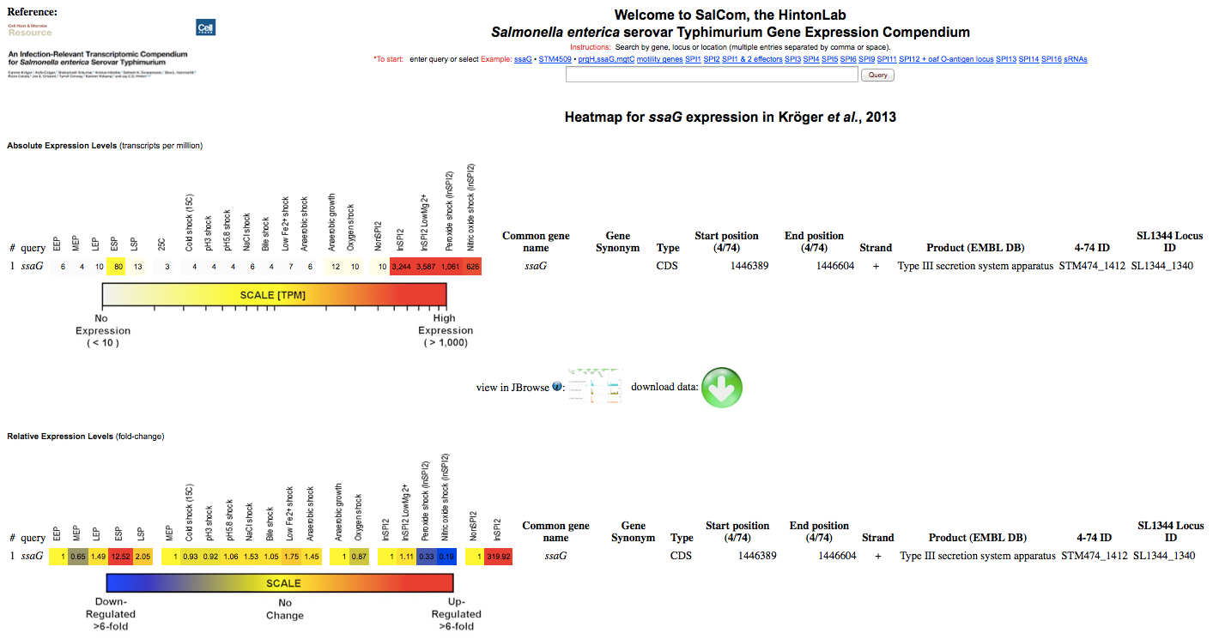
SalCom features

Slide 11
SalCom features
database query
absolute expression
gene annotation
data retrieval
differential expression

Slide 12
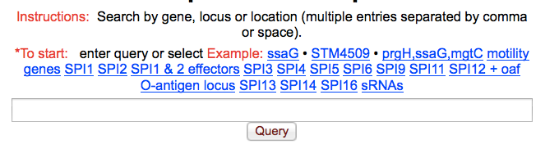
SalCom features

Slide 13
SalCom features

Slide 14
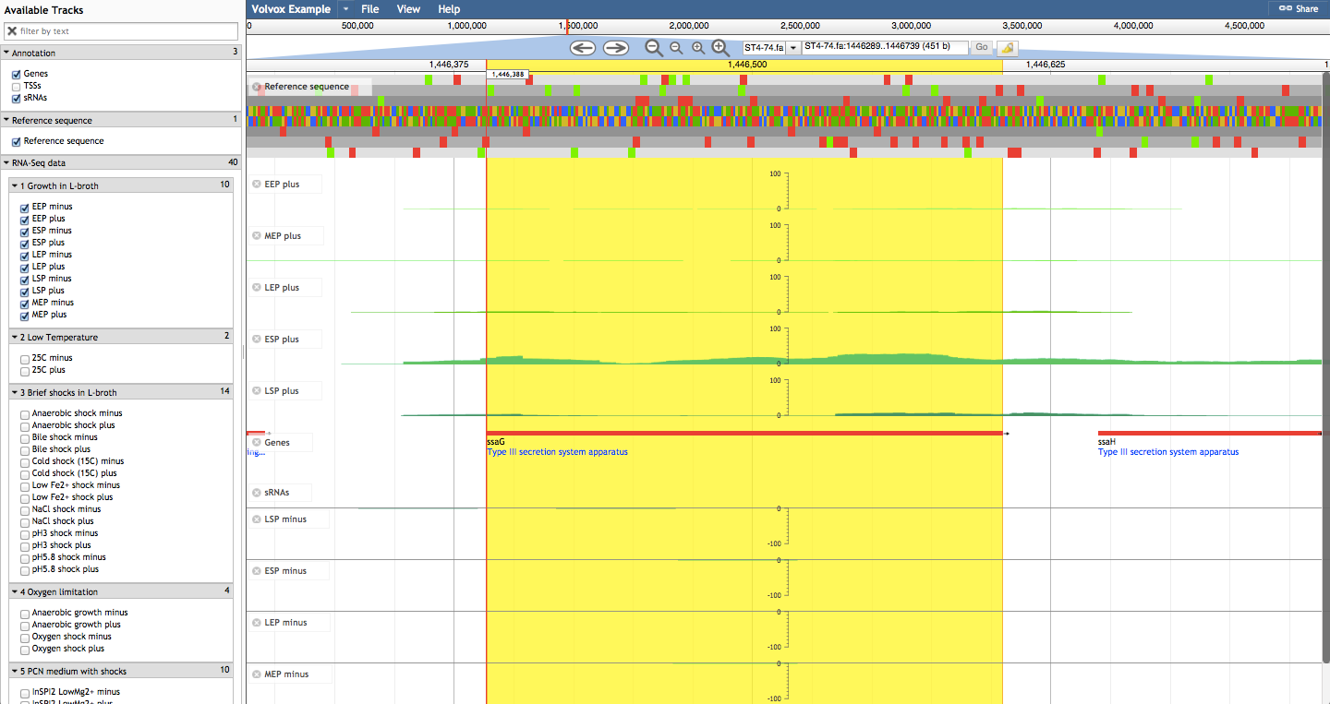
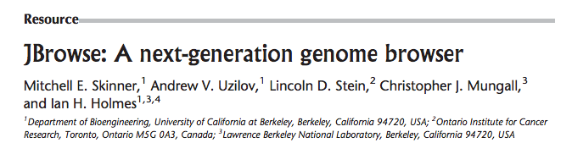
JBrowse
Genome Research, 2009

Slide 15
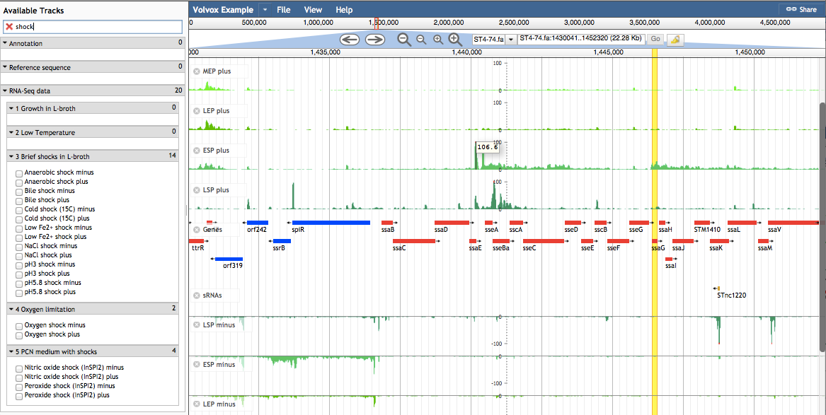
JBrowse features

Slide 16
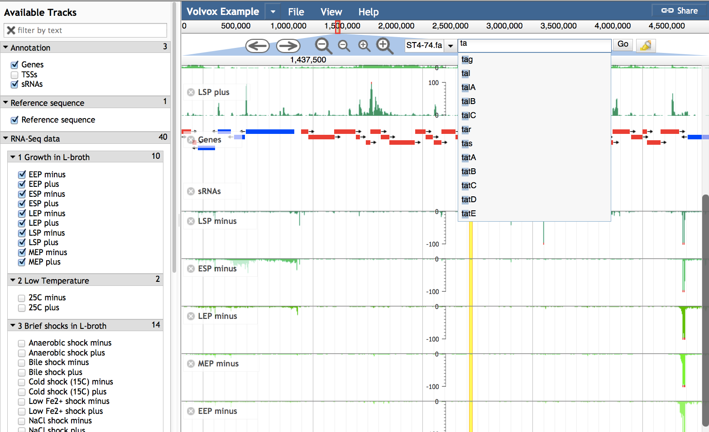
JBrowse features

Slide 17
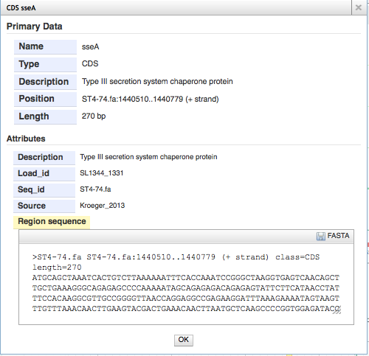
JBrowse features

Slide 18
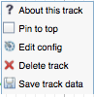
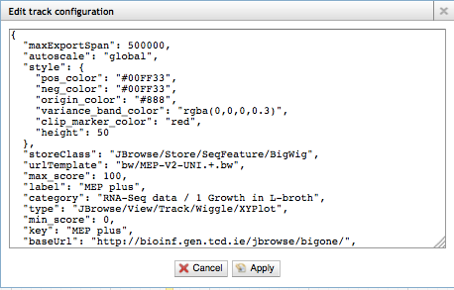
JBrowse features

Slide 19
JBrowse features

Slide 20
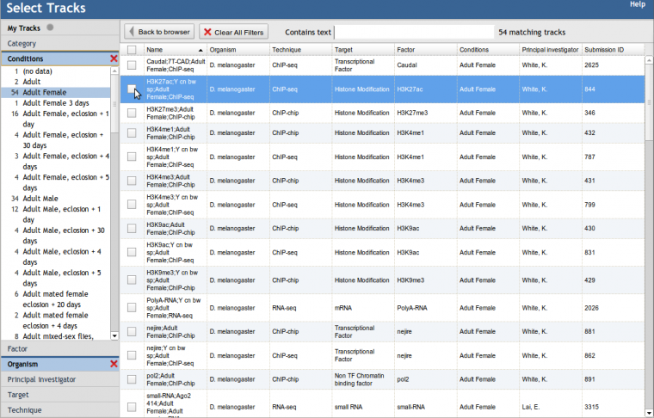
JBrowse features

Slide 21
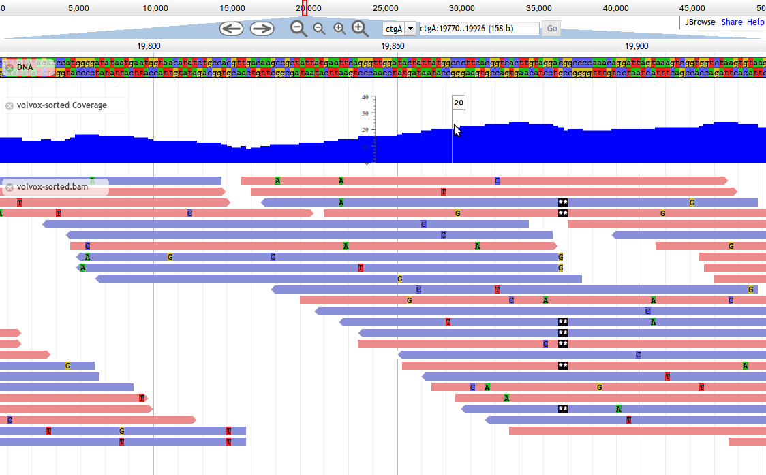
JBrowse features

Slide 22

Outlook
Many SalComs
JBrowse 2
Circular genome support
Subtracks
User configurable

Slide 23
Acknowledgements
Jay Hinton
His lab members
Tyrrell Conway
Joe Grissom
Robert Buehls

Slide 24
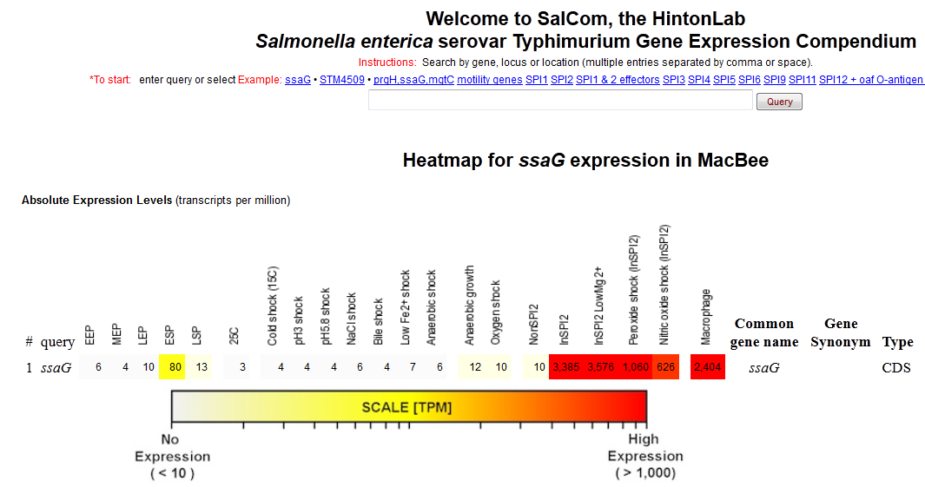


Unveiling SalCom v2.0

Slide 25
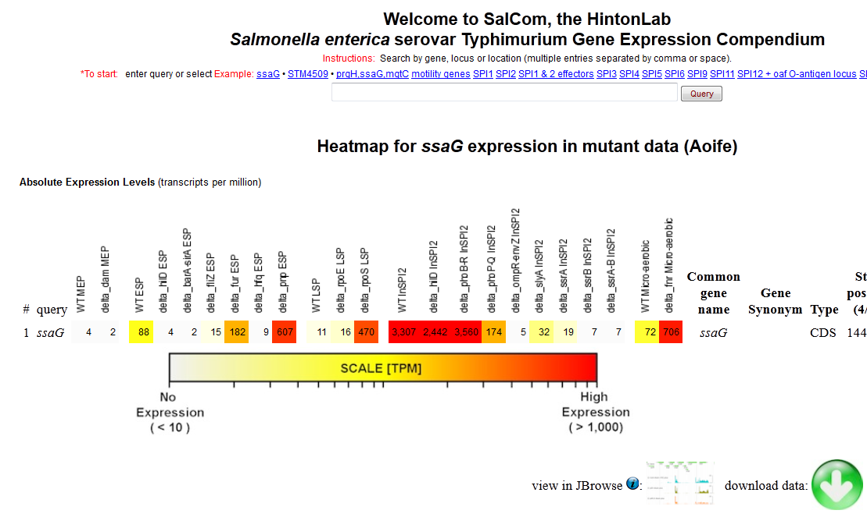
Unveiling SalCom v3.0

